Slide 1

DATA CLEANING IN SQL
BY PRAISWORTH LINDOKUHLE JONAS

Slide 2


WELCOME
A
B
INTRODUCTION
This project focuses on cleaning and preparing data using SQL to improve quality of the data and ensuring accuracy
OBJECTIVE
The primary objective of the project is to apply SQL data cleaning techniques to ensure
Accuracy
Complete
Ready for analysis
DATA CLEANING IN SQL

Slide 3

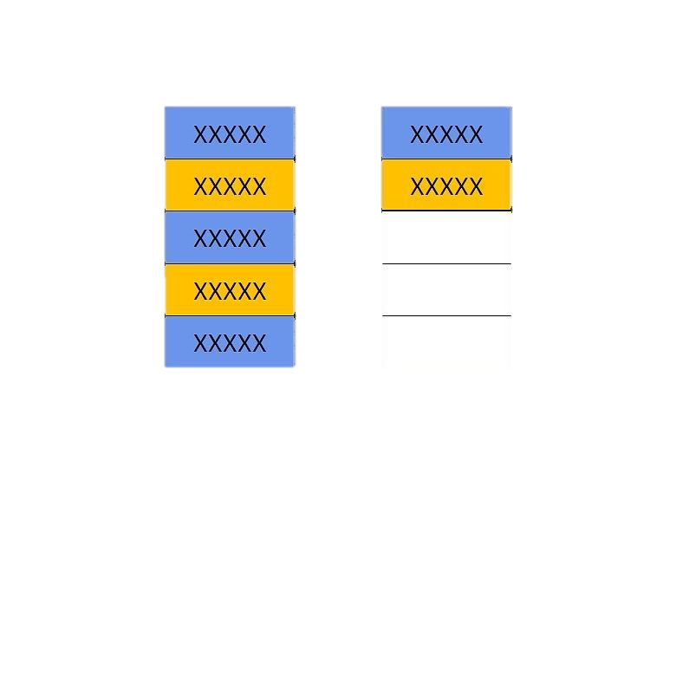
STEPS FOLLOWED
STEP 1
STEP 3
REMOVE DUPLICATES
STANDARDISING DATA
STEP 2
WORKING WITH NULLS AND BLANK VALUES

Slide 4
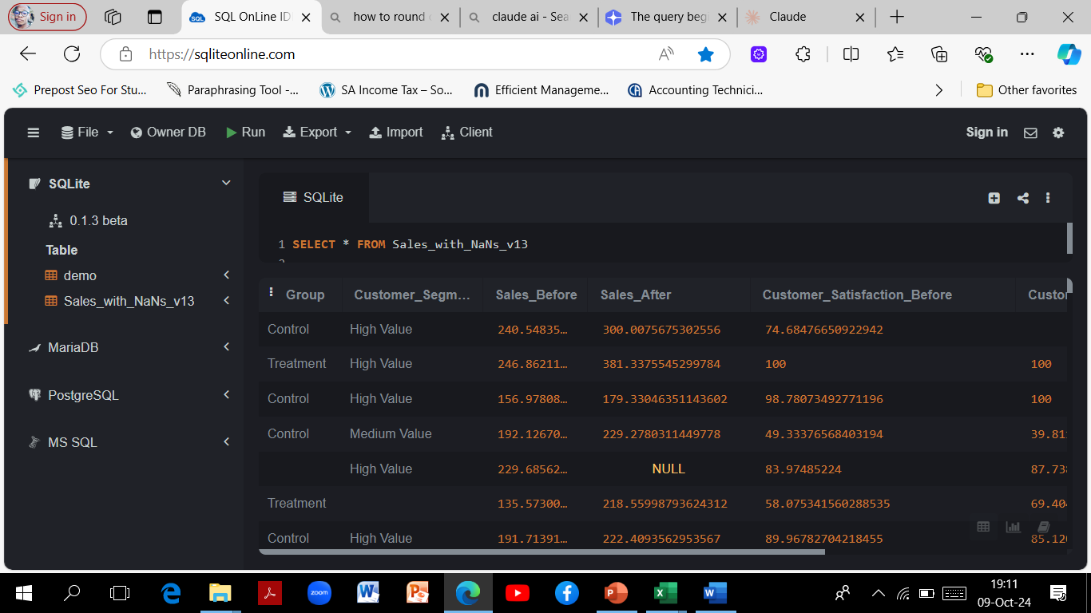
1. REMOVING DUPLICATES
SELECT * FROM Sales_with_NaNs_v13
Process includes
Identifying Duplicates
Selecting duplicates
Creating a new table
Inserting data to the new table
Removing Duplicates
Verification

Slide 5
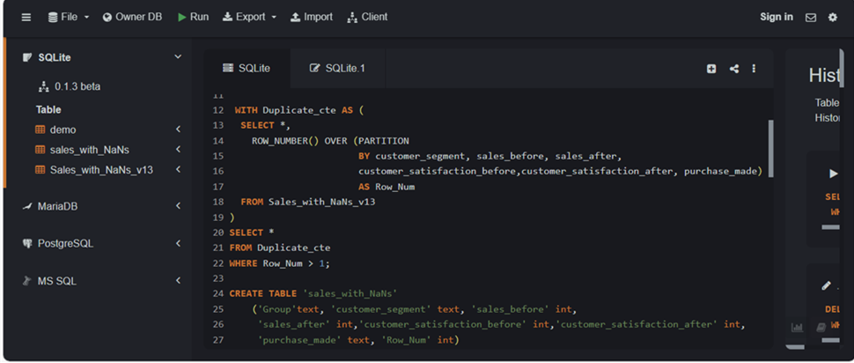
1.1. Identifying & Selecting Duplicates, Creating A New table
The query uses a Common Table Expression (CTE) named Duplicate_cte to identify duplicate records in the Sales_with_NaNs_v13 table. It employs the ROW_NUMBER() function with a PARTITION BY clause based on several fields: client_segment, sales_prior, sales_following, client satisfaction prior to, client satisfaction following, and acquisition_made. Each group of duplicates is assigned a distinct row number starting from 1.After assigning row numbers, the query filters the results to select only those records where Row_Num is greater than 1, indicating they are duplicates. This method effectively isolates identical copies for further analysis or removal.
A new table called sales_with_NaNs is created to store records, including a Row_Num column to track duplicates.

Slide 6
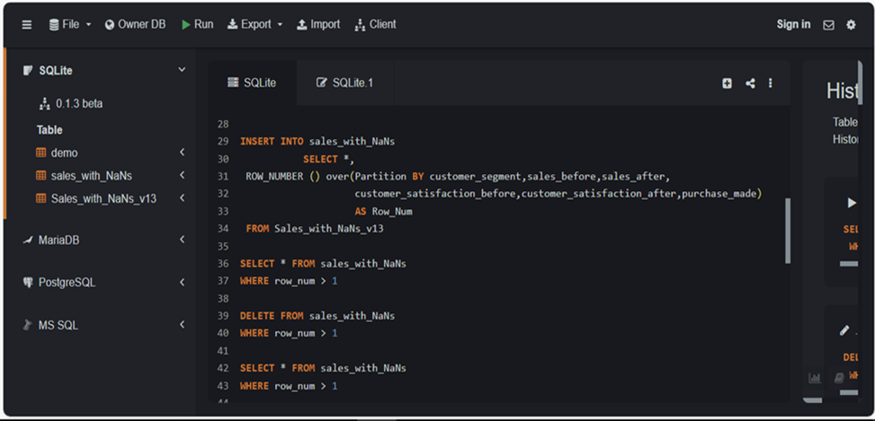
1.2. Inserting data to the new table, Removing Duplicates, Final verification.
The query inserts records into this table while reassigning row numbers using the ROW_NUMBER() method to maintain duplicate tracking.
To eliminate duplicates, the query purges entries where Row_Num is greater than 1, effectively removing all duplicate records and leaving only unique entries in the table.
Finally, the query checks for any remaining duplicates by selecting records with Row_Num greater than 1. If the deletion was successful, this check should return an empty result set.
This structured approach ensures that duplicates are systematically identified, stored, and removed, thereby maintaining the integrity of the dataset.

Slide 7
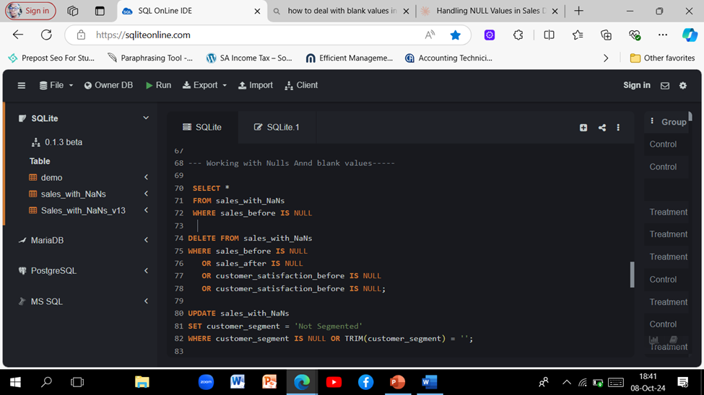
2. WORKING WITH NULLS AND BLANK VALUES
2.1. Identify Records with NULL ValuesThe first step is to retrieve all records from the sales_with_NaNs table where the sales_before field is NULL. This helps in understanding the extent of the data quality issue.
2.2. Delete Records with NULL Values, The query removes entries where values are = NULL .This step ensures that the dataset is cleaned of incomplete records.
2.3. Update Customer Segment, After cleaning the data, the next step is to update the customer_segment field. Records where customer_segment is either NULL or consists of only blank space are set to 'Not Segmented'. This ensures that all records have a valid customer segment designation.
SELECT * FROM sales_with_NaNs
Finally, the process concludes with a verification step to ensure that the updates and deletions were successful. This is done by selecting all records from the sales_with_NaNs table to review the current state of the data.

Slide 8
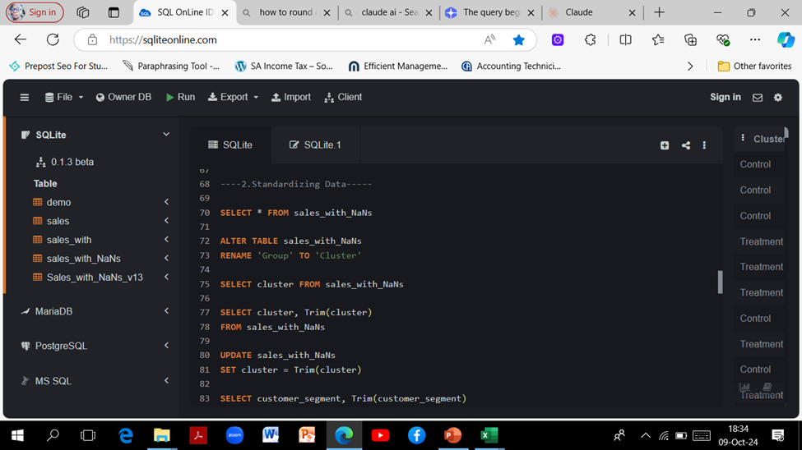
3. STANDARDIZING DATA
3.1. Retrieve All Records: The process begins by selecting all records from the sales_with_NaNs table to review the current data.
3.2. Rename a Column: The column named Group is renamed to Cluster to avoid conflicts with SQL reserved keywords.
3.3. Verify the Renamed Column: After renaming, the new column is checked to confirm the change.
3.4. Trim Whitespace from the Cluster Column: The Cluster column is retrieved alongside its trimmed version to identify any leading or trailing whitespace.
3.5.Update the Cluster Column: The Cluster column is updated to remove any whitespace, ensuring all entries are clean and standardized.

Slide 9
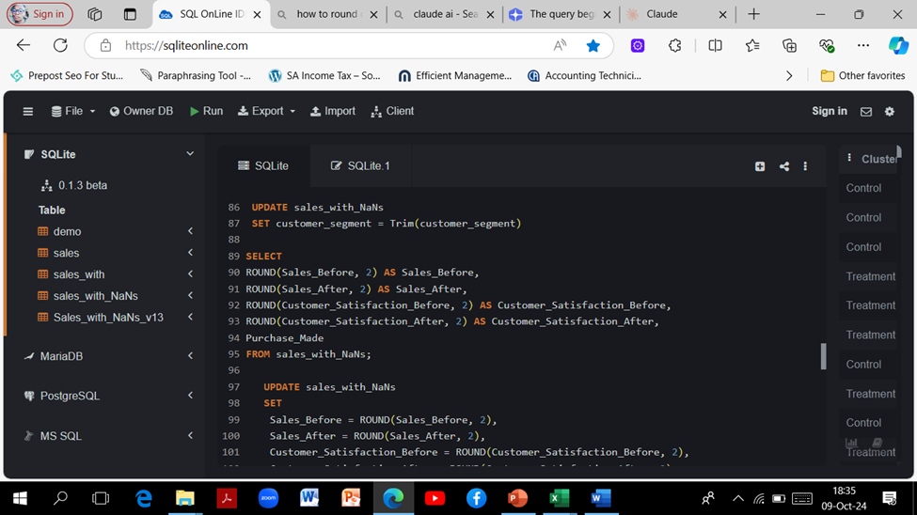

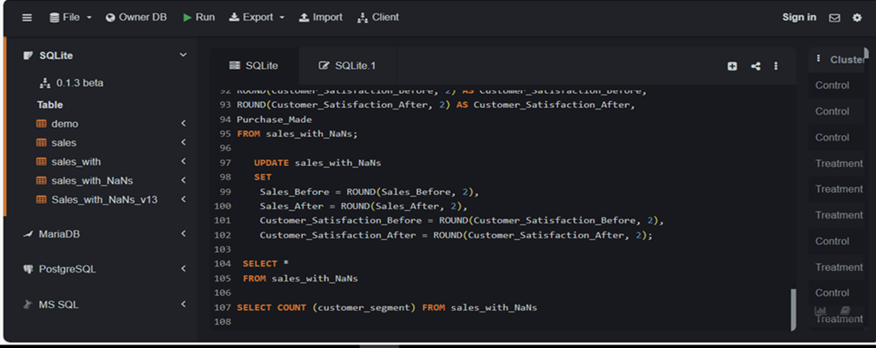
3.6. Verify Customer Segment Data: The customer_segment column is checked, retrieving it with its trimmed version to identify whitespace issues
3.7. Update the Customer Segment Column: Similar to the Cluster column, the customer_segment column is updated to remove leading or trailing whitespace.
3.8. Round Numerical Values: The numerical fields are selected and rounded to two decimal places for better precision in reporting.
3.9. Update Numerical Values: The numerical fields in the table are updated to ensure they are rounded to two decimal places.

Slide 10
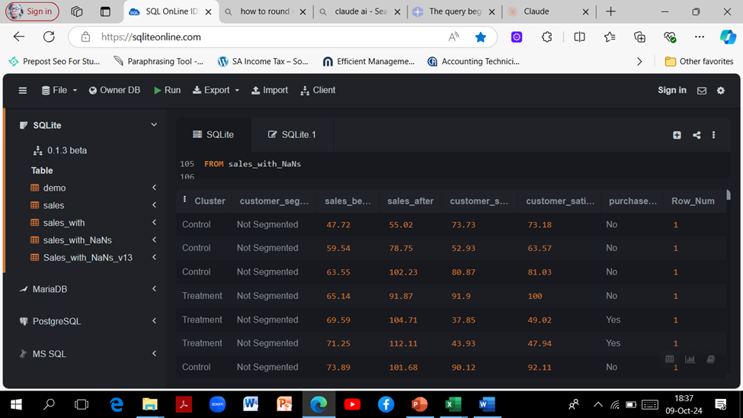
3.10. Final Verification: The process concludes by selecting all records from the sales_with_NaNs table to verify that all updates and changes have been applied correctly. This structured approach ensures data consistency and integrity within the sales_with_NaNs table.

Slide 11
CONCLUSION
In conclusion, this SQL project's data cleaning procedure has shown to be a crucial step in guaranteeing the accuracy and dependability of our dataset. By finding and eliminating duplicates, working with NULLS and blank values, and standardizing data, I have improved the quality of our data—a critical component for precise analysis and well-informed decision-making. The methods used, which include filtering, and normalization using SQL queries, have given me the skills I need to keep my database organized and effective.

